Slide 1
Chronic myelogenous leukemia

Slide 2
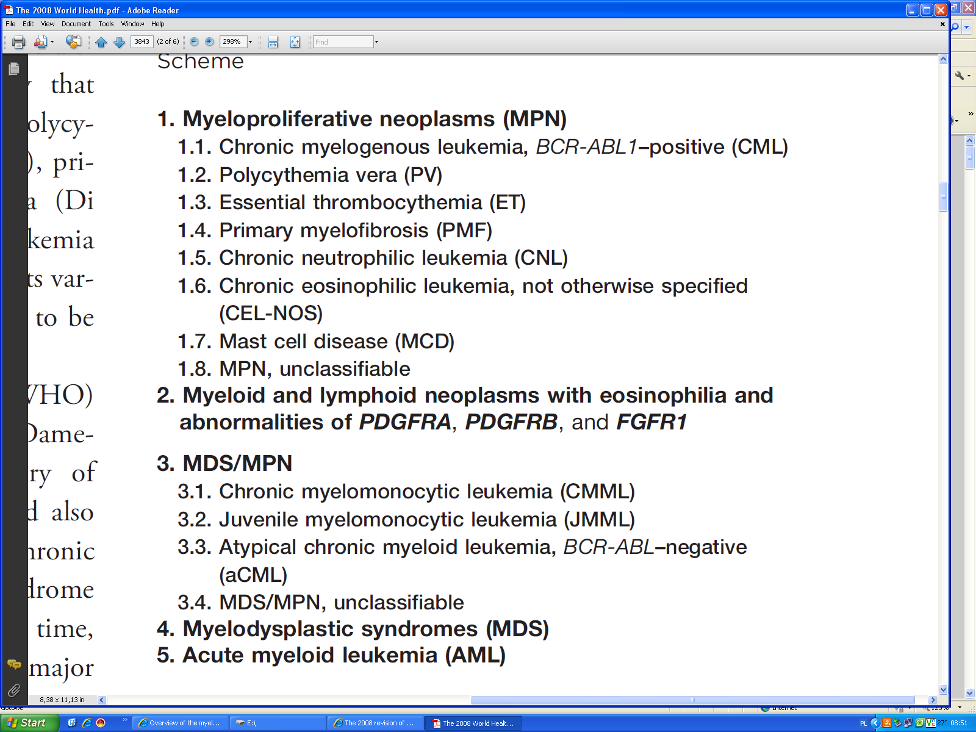
Classification of Myeloid Neoplasms According to the 2008 World Health Organization Classification Scheme

Slide 3
CML results from a somatic mutation in a pluripotential lymphohematopoietic cell
CML is a MPD characterized by increased granulocytic cell line, associated with erythroid and platelet hyperplasia
The disease usually envolves into an accelerated phase that often terminates in acute phase
chronic phase 3-5 years
accelerated phase
blastic phase 3-6 months

Slide 4
Epidemiology
CML accounts for approximately 15 percent of all cases of leukemia and approximately 3 percent of childhood leukemias
The median age of onset is 53 years
Frequency 1/100 000 people from general population

Slide 5
Pathogenesis
Hematopoietic abnormality
Expansion of granulocytic progenitors and a decreased sensitivity of the progenitors to regulation → increased white cell count
Megakaryocytopoiesis is often expanded
Erythropoiesis is usually deficient
Function of the neutrophils and platelet is nearly normal

Slide 6
Pathogenesis
Genetic abnormality
CML is the result of an acquired genetic abnormality
A translocation between chromosome 9 and 22 [t(9;22)] – the Philadelphia chromosome
The oncogene BCR-ABL encodes an enzyme – tyrosine phosphokinase (usually p210)

Slide 7
Philadelphia Chromosome
More than 95% of patients with CML has Philadelphia (Ph) chromosome
A subset of patients with CML lack a detectable Ph chromosome but have the fusion product for the BCR-ABL translocation detectable by reverse transcriptase- polymerase chain reaction (RT-PCR)

Slide 8
The bcr/abl fusion protein
Uncontrolled kinase activity
Deregulated cellular proliferation
Decreased adherence of leukemia cells to the bone marrow stroma
Leukemic cells are protected from normal programmed cell death (apoptosis)

Slide 9
Clinical features
30 percent of patient are asymptomatic at the time of diagnosis
Symptoms are gradual in onset:
  easy fatigability, malaise, anorexia, abdominal discomfort, weight loss, excessive sweating
  Less frequent symptoms:
  Night sweats, heat intolerance- mimicking hyperthyroidism, gouty arthitis, symptoms of leukostasis (tinnitus, stupor), splenic infartion (left upper-quadrant and left shoulder pain), urticaria (result of histamine release)
  Physical signs:
  Pallor, splenomegaly, sternal pain

Slide 10
Laboratory features
The hemoglobin concentration is decreased
Nucleated red cells in blood film
The leukocyte count above 25000/μl (often above 100000/μl), granulocytes at all stages of development
Hypersegmentated neutrophils
The basophiles count is increased
The platelet count is normal or increased
Neutrophils alkaline phosphatase activity is low or absent (90%)

Slide 11
Laboratory features (2)
The marrow is hypercellular (granulocytic hyperplasia)
Reticulin fibrosis
Hyperuricemia and hyperuricosuria
Serum vitamin B12-binding proteine and serum vitamin B12 levels are increased
Pseudohyperkalemia, and spurious hypoxemia and hypoglycemia
Cytogenetic test- presence of the Ph chromosome
Molecular test – presence of the BCR-ABL fusion gene

Slide 12
Differential diagnosis
Polycythemia vera
Myelofibrosis
Essential thrombocytemia
Extreme reactive leukocytosis

Slide 13
CML stages
In chronic phase, fewer than 10% of the cells in the blood and bone marrow are blast cells.
Accelerated phase
In accelerated phase CML, 10% to 19% of the cells in the blood and bone marrow are blast cells.
Blastic phase
In blastic phase CML, 20% or more of the cells in the blood or bone marrow are blast cells. When tiredness, fever, and an enlarged spleen occur during the blastic phase, it is called blast crisis.

Slide 14

Treatment
Prognostic factors
Sokal score =
  = (11x age + 35x spleen + 89x blasts + 0,4x platelet – 550)/1000
Euro scale =
  = (0,666x age /0 when age <50, 1 when >/ + 0,0420x spleen + 0,0584x blasts + 0,0413x eosinophils + 0,2039x basophils /0 when basophils <3%, 1 when basophils >3%/ + 1,0956x platelet /0 when platelet <15000G/l, 1 when >/) x 1000

Slide 15
EUTOS SCORE
The new EUTOS score predicts complete cytogenetic remission (CCgR) 18 months after the start of therapy, which is an important predictor for the course of disease. Patients without CCgR at this point of treatment are less likely to achieve one later on and are at a high risk of progressing to blastic and accelerated phase disease
The strongest predictors for CCgR at 18 months are spleen size and percentage of basophils. Spleen size is measured in cm under the costal margin, basophils as their percent in peripheral blood. Both need to be assessed at baseline. Their relationship to CCgR is expressed by the formula:
7 * basophils + 4 * spleen size
If the sum is greater than 87, the patient is at high risk of not achieving a CCgR at 18 months, while a sum less than or equal to 87 indicates a low risk

Slide 16
Treatment
IKT (imatinib, nilotinib, dasatinib)
Allo- SCT

Slide 17
Treatment
Hydroxyurea
Often used initially for white cell count reduction
Dose: 1-6g/d orally, depending on the hight of the white cell count
The dose should be decreased to 1-2g/d when the leukocyte count reaches 20000/µl
Drug should be stopped if the white count falls to 5000/µl
Side effects: suppression of hematopoiesis, often with megaloblastic erythropoiesis

Slide 18
Treatment
Interferon-alfa
In CML patients during preganancy
Patients with low risk (Sokal/Euro score) and high TRM, patient not eligible for alloSCT (treatment initiated before imatynib era)
Dose: 3million units/m² subcutaneously 3 days per week, and after 1 week – 5 million u/m². Maximal dose: 5 million u/m² per day. After maximal response (6-8 months) 3-5 million u/m² once or twice weekly
Dose should be reduced or teporarily discontinued if the white cell count less than 5000/µl or platelet count less than 50000/µl

Slide 19
Treatment
Interferon alfa
Initial side effects of INFalfa: fever, fatigue, sweats, anorexia, headache, muscle pain, nausea, and bone pain – 50% of patients
Later effects: apathy, insomnia, depression, bone and muscle pain, hepatic, renal and cardiac dysfunction, immunemediated anemia, thrombocytopenia, hypothyroidism, hypertriglyceridemia
Hematologic improvement – 75% of patients, cytogenetic remission – 10%, molecular remission- 2%
A polyethylene glycol-conjugated interferon-alfa (PEG-interferon)- better toleration, treatment once per week

Slide 20
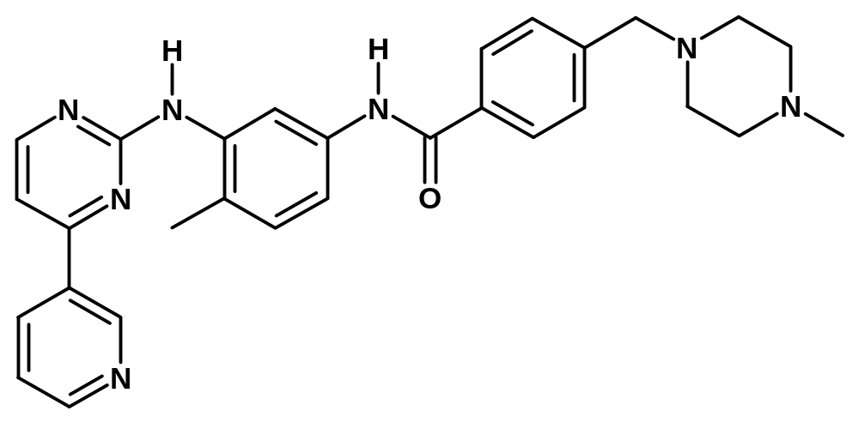
CGP57148; STI571; imatinib; Glivec
TK inhibitory activity
Stability to hydrolysis
Solubilisation
No PKC inhibition
Potent inhibition of Abl-K, c-kit and PDGF-R
Salts are soluble in water
Orally bioavailable
Not mutagenic
Cellular permeability
1992

Slide 21
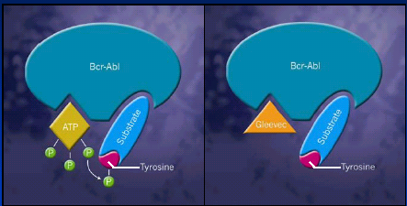

Slide 22
Traetment
Imatinib mesylate (Gleevec)
Inhibits activity of mutant tyrosine kinase by blocking ATP binding
Imatinib has less toxicity, is easier to administer, and induces higher hematologic (90 percent vs. 75percent), cytogenetic (40 percent vs. 10 percent) and molecular (7% vs. 2 %) types of remission
Dose: 400mg/d orally (maximal dose 600-800mg/d in two divided doses)

Slide 23
Treatment
Imatinib mesylate
Side effects: nausea, vomiting, edema, muscle cramps, diarrhea, headache, abdominal pain- usually low-grade
The drug can be used prior the alloSCT if eligible, or nonmyeloablative SCT for older patient

Slide 24
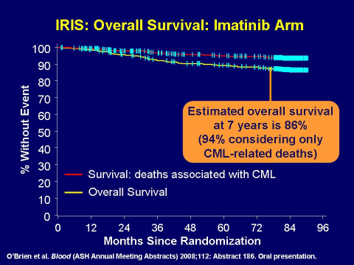

Slide 25
TK inhibitors 2007
Abl TK inhibitors
  Imatinib (Novartis)
  Nilotinib (AMN107, Novartis)
Dual Abl/Src inhibitors
  Dasatinib (BMS 254825, Bristol-Myers Squibb)
  SKI-606 - ‘bosutinib’ (Wyeth)
  AP23464 (Ariad Pharmaceuticals)
  AZD0530 (Astra-Zeneca)
Dual Abl/Lyn inhibitor
  NS-187 (INNO-406) (Nippon-Shinyaku)
Non-ATP-binding inhibitors active against T315I
  ON 012380 (Onconova)
  VX-680 (Aurora kinase inhibitor) → Merck 0457 - T315I
  SGX-70430 (SGX Pharma)
  GNF-2 (Genomics Novartis Foundation)

Slide 26
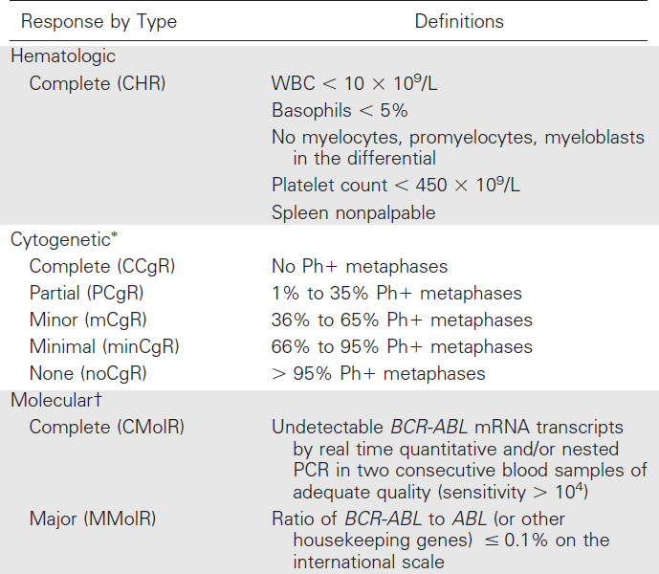
Definitions of hematologic, cytogenetic, and molecular response

Slide 27
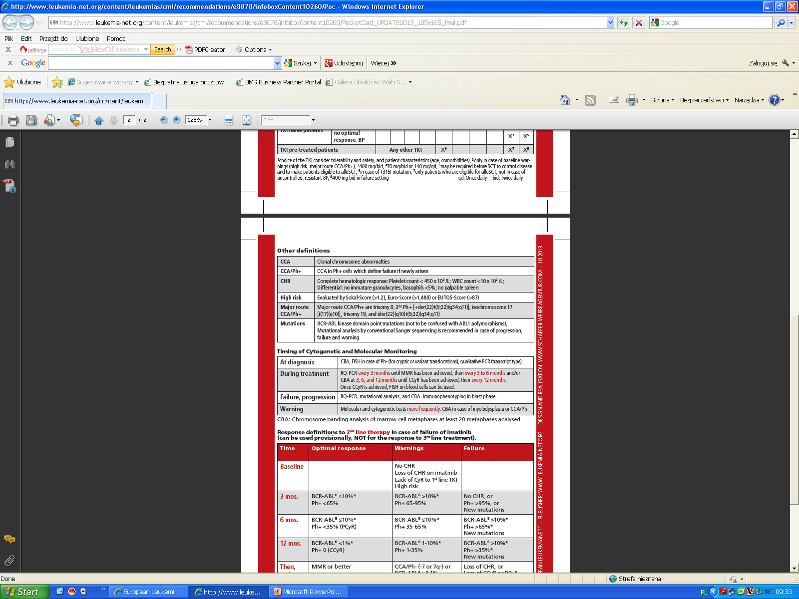
European LeukemiaNet Recommendations for the Management
of Chronic Myeloid Leukemia (CML)
Baccarani et al, Blood 2013;122:872-884

Slide 28
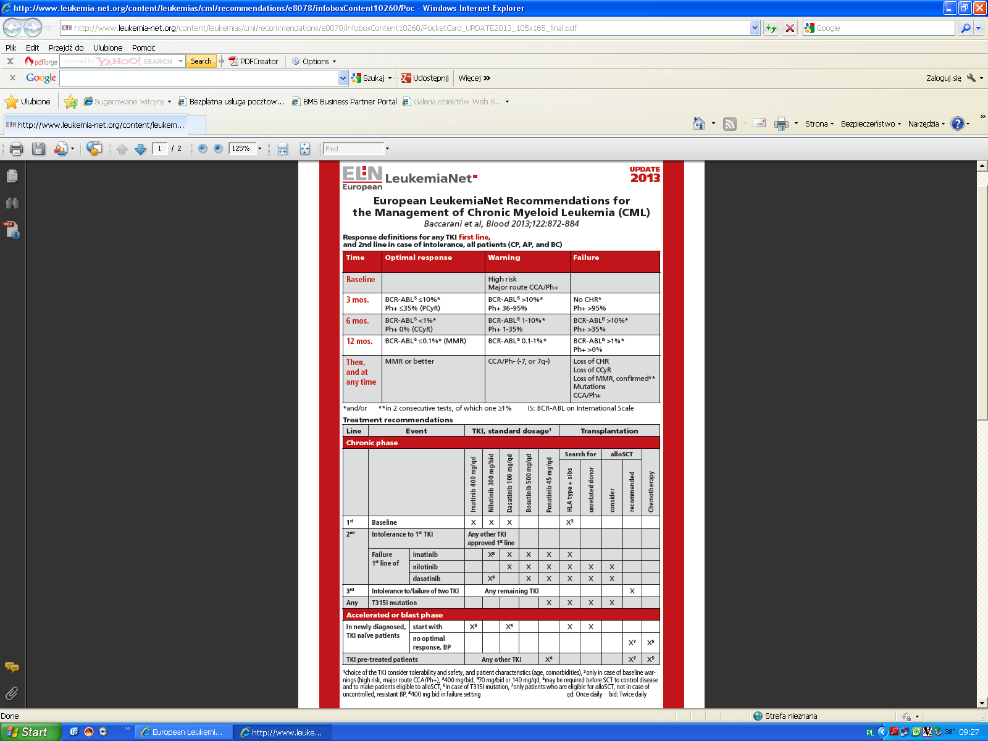
Baccarani et al, Blood 2013;122:872-884

Slide 29
European LeukemiaNet Recommendations for the Management
of Chronic Myeloid Leukemia (CML)
Baccarani et al, Blood 2013;122:872-884

Slide 30
European LeukemiaNet Recommendations for the Management
of Chronic Myeloid Leukemia (CML)
Baccarani et al, Blood 2013;122:872-884

Slide 31
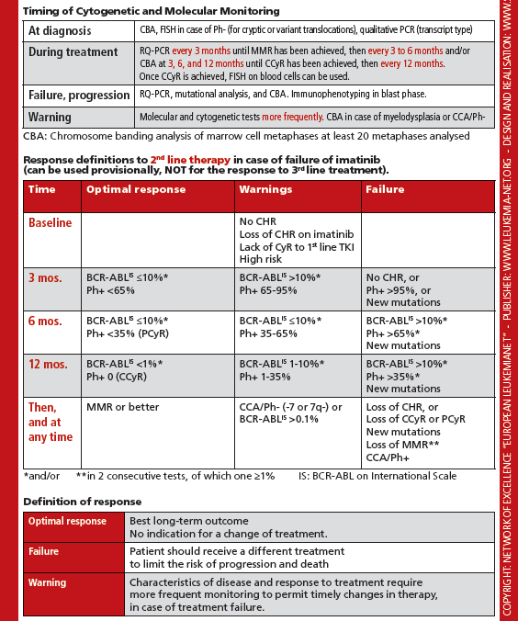
European LeukemiaNet Recommendations for the Management of Chronic Myeloid Leukemia (CML)
Baccarani et al, Blood 2013;122:872-884

Slide 32
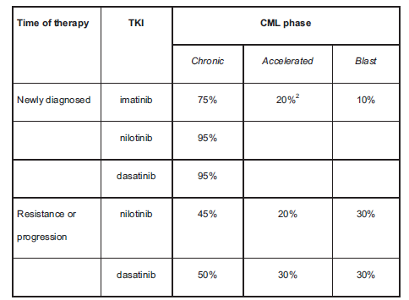
CCyR rates for approved TKIs

Slide 33
Treatment
Early alloSCT
The early mortality in younger patient (below 40 years of age) – 15 percent
5-year survival can be achieved in 60 percent of patients in chronic phase (some can be cured)
There is 20 percent chance of relapse of CML in the years after succesful transplantation
Donor lymphocyte infusion (DLI) can produce remission in transplanted patiens who have relapse of their disease

Slide 34
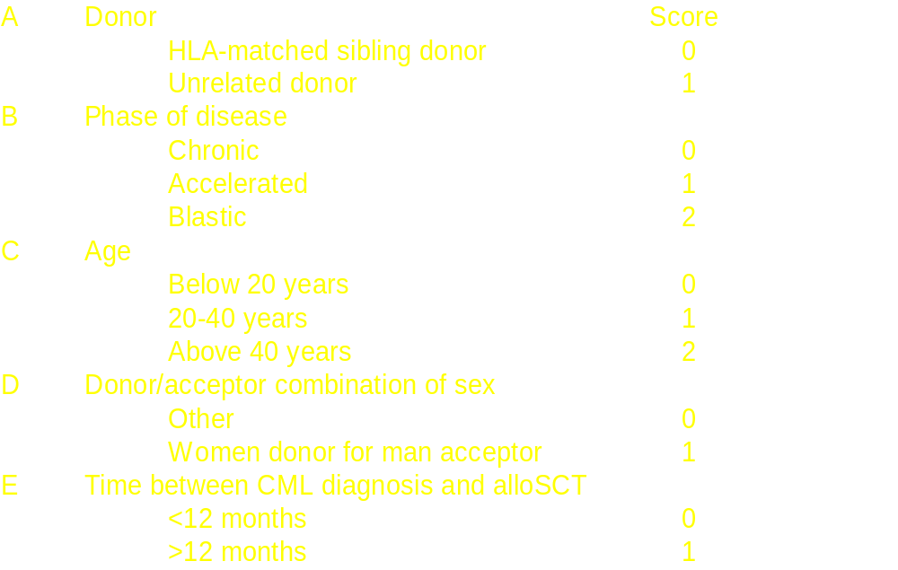
Treatment
Risk of transplant-related mortality (TRM)

Slide 35
Probability of survival after HLA-matched sibling donor transplant for CML, by disease status and transplant year, 1998-2008
100
100
90
90
80
80
CP, 2001-2008 (N=2,412)
70
70
60
CP, 1998-2000 (N=2,302)
60
Probability of Survival, %
50
AP, 2001-2008 (N=314)
50
40
40
AP, 1998-2000 (N=301)
30
30
20
20
10
10
P < 0.0001
0
0
0
1
2
3
4
5
6
Years
Notes:
Slide 39: The CIBMTR has data for 5,329 HLA-matched sibling donor transplants for CML patients in chronic phase (CP, n=4,714) and in accelerated phase (AP, n=615) between 1998 and 2008. Among patients in CP, the 3-year probabilities of survival were 69% ± 1% for the period 1998 to 2000, and 71% ± 1% for transplants in performed from 2001 to 2008. Corresponding 3-year survival probabilities for patients in AP were 45% ± 3% and 56% ± 3%.

